Slide 2
IAP Immunization Timetable 2013
Prepared by:
IAP Advisory Committee on Vaccines & Immunization Practices (ACVIP)

Slide 3
Mobile App
Home
Grid & Sliding Menu
Social Media
About Us
Our Team
FAQ
Dynamic Charts
Instruction
Contact Info

Slide 4
Home
&
Grid View Menu

Slide 5
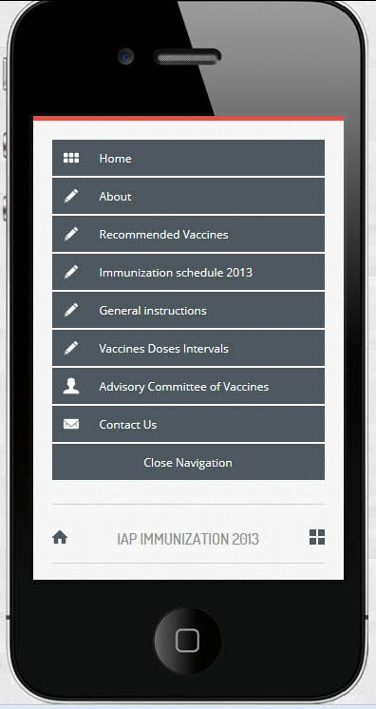
Sliding menu
This menu display with slide effect when we click on grid menu icon

Slide 6
Social Media Link & Button To move on top

Slide 7
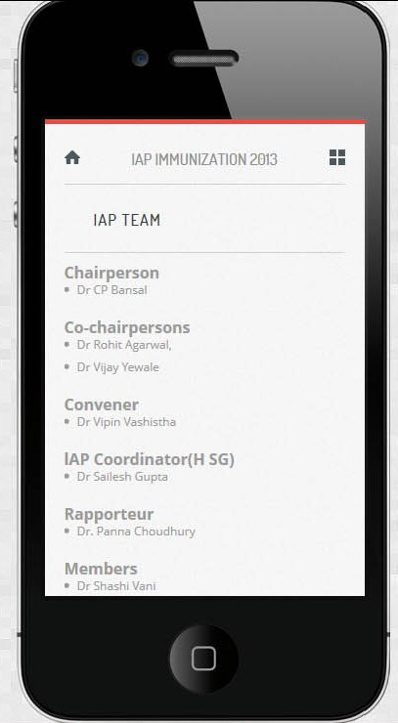
Our Team
List of Team Member with designations

Slide 8
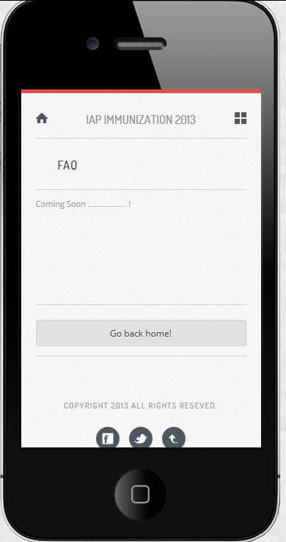
FAQ
Different Question and answer

Slide 9
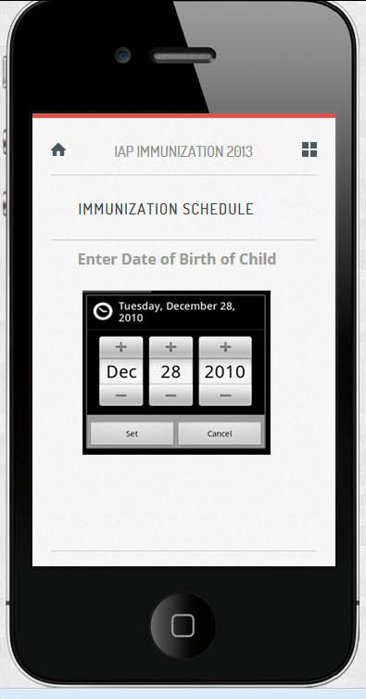
Dynamic Charts & Time Table
Its take input date of birth of child and result as per child’s age

Slide 10
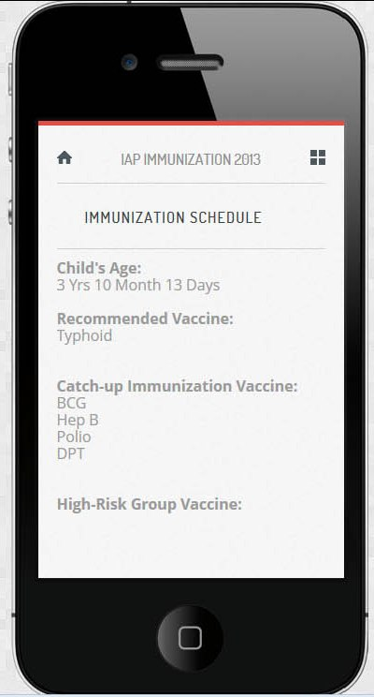
Dynamic Charts & Time Table
Result

Slide 11
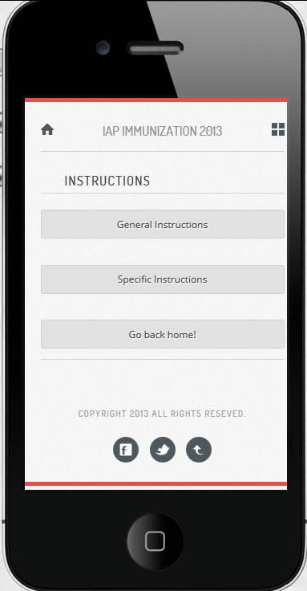
Instructions
General
Specific

Slide 12
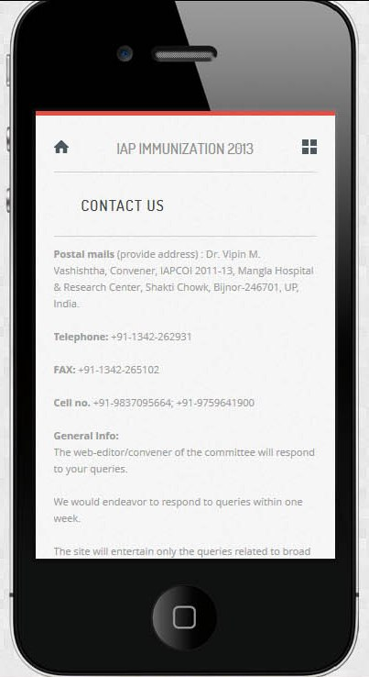
Contact Us
All Contact Info are here

Slide 13
Thank You

